Slide 1
Final Project Presentation
CSE465: Pattern Recognition and Neural Network
Heart Disease Prediction
Presented By-
Muhtasim Munem Mugdho
ID: 1611059042

Slide 2
Project analysis slide 4
Work Done
Dataset
Accuracy Check
Testing Dataset
Algorithm
Evaluation
Model
Evaluation
Find Best Classifier
Training Dataset
Confusion matrix
Random Forrest
Support
Vector
Logistic Regression
KNN

Slide 3
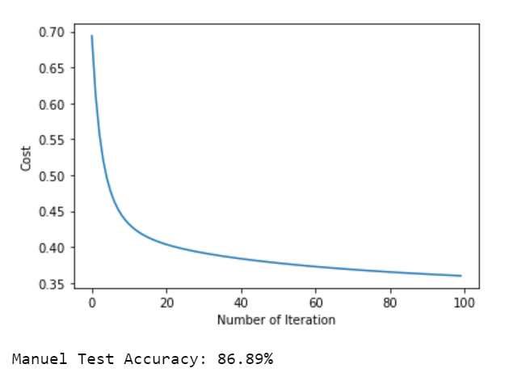
Project analysis slide 4
Logistic Regression
Confusion matrix,

Slide 4
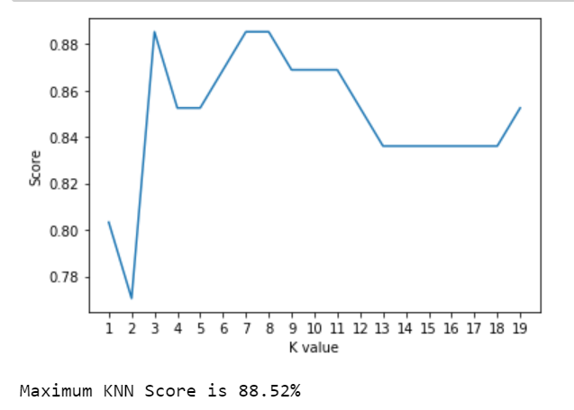
Project analysis slide 4
KNN
Confusion matrix,

Slide 5
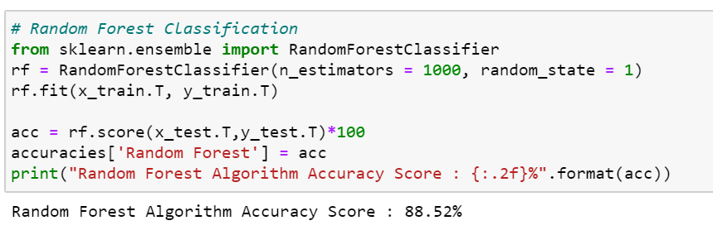
Project analysis slide 4
Random Forest Classification
Confusion matrix,

Slide 6
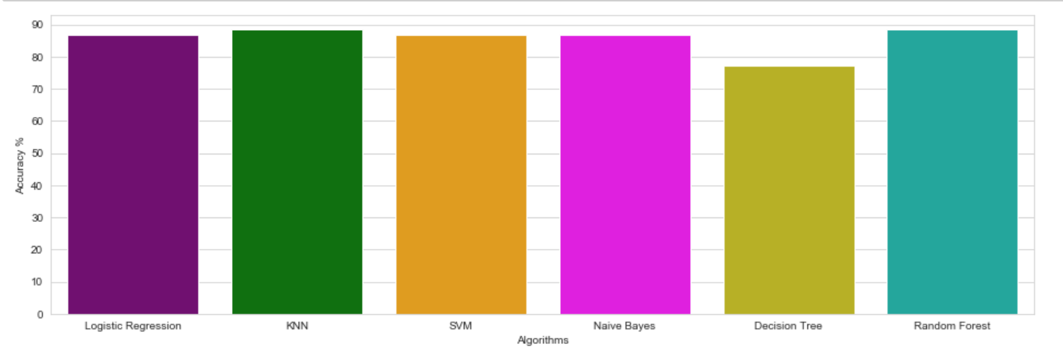
Project analysis slide 4
Accuracy of Different Algorithms
Confusion matrix,

Slide 7
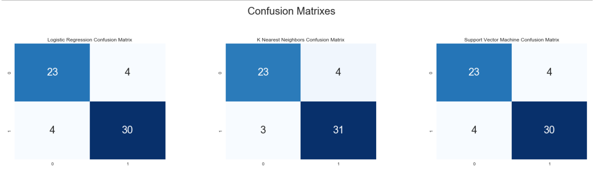
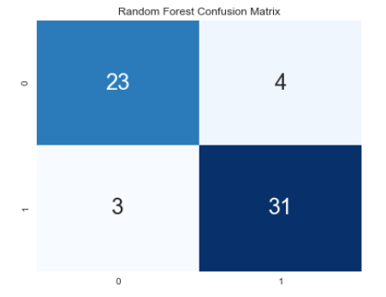
Project analysis slide 4
Confusion Matrix
Confusion matrix,

Slide 8
Thank You

